Slide 1

How Can a Wellness Technology Company Play It Smart?
Google Data Analytics Certification – Capstone Case Study
Make informed
decisions about your
health. Every day.
The only health tracker designed and engineered for
women.
Presented by:
Nipurn Gupta
October 17, 2022

Slide 2
Business Task
Bellabeat, a high-tech manufacturer of health-focused products for women, has the potential become a large player in the global smart device market.
Identify trends in usage of smart devices to make recommendations to marketing team for growth opportunities.

Slide 3
Insights
Data indicates Calorie and Step tracking to be the most popular Fitbit features.
Weight tracking is the least popular feature.

Slide 4
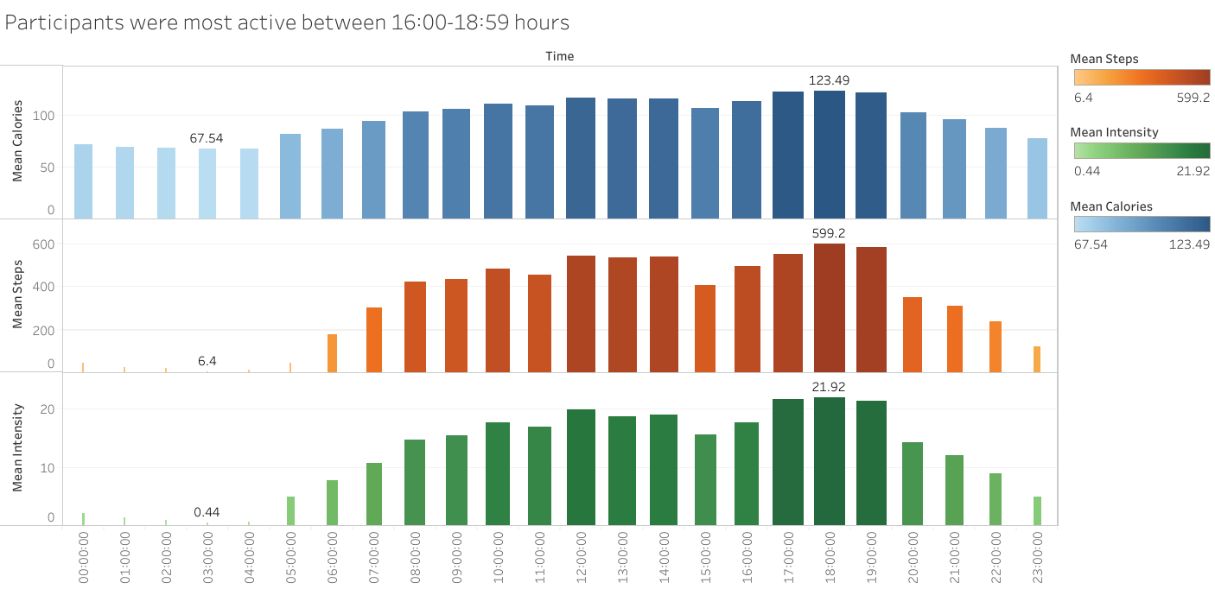
Insights
Participants most active between 16:00-18:59 hours.
Surprisingly, data indicates of calories being burnt during inactive time periods.

Slide 5
Insights
81.3% of time is spent in inactive moments or being seated.
Participants were lightly active for 15.8% of the time.
Only 1.11% of the time accounted for fairly active minutes.
Surprisingly, 1.74% of the time was spent on very active minutes.

Slide 6
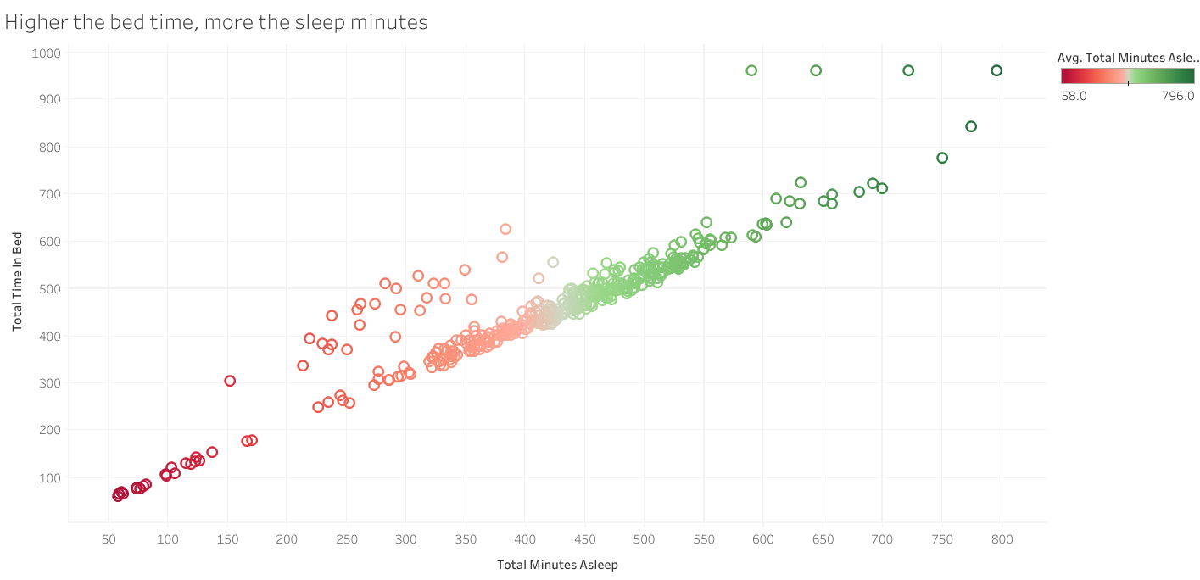
Insights
Higher the bed time, more the sleep minutes.
Few participants have spent a lot of time in bed, but did not sleep.

Slide 7
Recommendations
The sample size of 33 participants is not representative of the population. More data is needed for an accurate analysis.
Health trackers could give a notification encouraging users to take small breaks between long inactive moments.
Benefits of sleep (proper sleep = burns calories), weight tracking could be adopted in strategies.
Bellabeat app could introduce sleep inducing apps, to decrease the gap between time in bed vs minutes asleep.
Smart Weighing Scales could be conceptualized to encourage weight tracking among fitness users.

Slide 8
Questions?
Datasource: https://www.kaggle.com/arashnic/fitbit
Other projects: https://github.com/nipurngupta

